Slide 1
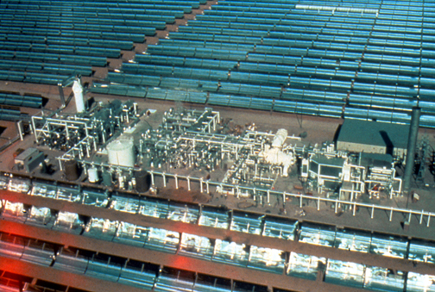
High-Temperature Solar Thermal Systems
Dishes, Troughs, and Other Concentrators Increase the Power of the Sun

Slide 2
One type of active solar system in use today involves high-temperature concentrating solar thermal systems
These systems convert the sun’s heat into both electricity and hot water at the same time for many uses. They offer electrical power for both remote and utility-scale applications. Because of their economies of scale and efficiencies, they can work in many large-scale projects where other sources of energy are not yet economical.

Slide 3
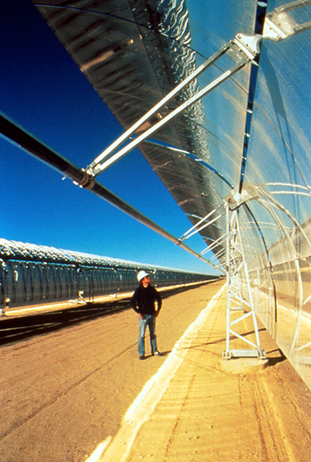
Trough Systems
One type of high-temperature system is the trough system, in which the troughs focus sunlight onto steel pipes or glass tubes. The heat transfer fluid in the pipes reaches more than 700 degrees F and flows through a heat exchanger, providing superheated steam for a turbine generator.

Slide 4
The most successful trough systems are the Solar Electric Generating Stations in Southern California, which produce more than 350 MW of electricity – enough energy to meet the residential needs of thousands of people.

Slide 5
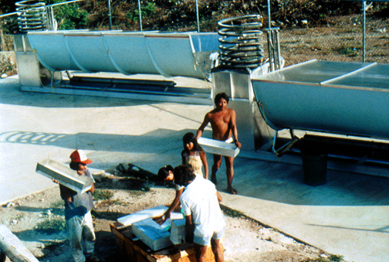
The applications of these technologies are quite varied. One interesting use of troughs is concentrating the sun’s power to produce ice, as is done in these solar icemakers in Mexico. Villages can now keep their fish fresh as they transport their catch to neighboring towns.

Slide 6
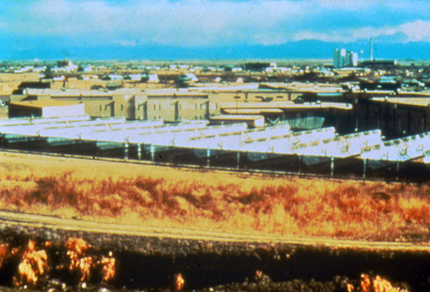
Another trough system is the Adams County Detention Facility in Colorado, which has produced both hot water and electricity. A fluid in the system is heated to 350 degrees F in the receiver tubes to produce the needed heat.

Slide 7
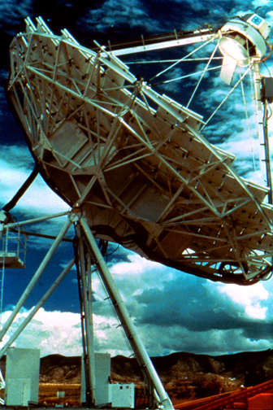
Dish Systems
A second type of high-temperature solar thermal system is a dish system, which uses a parabolic tracking concentrator to focus the sun’s rays onto a receiver mounted above the dish at its focal point.

Slide 8
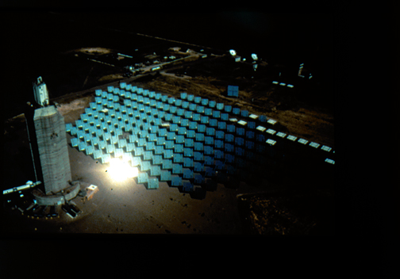
Finally, the third type of system is the Central Receiver, which uses sun-tracking mirrors called heliostats to reflect solar energy to a receiver atop a tower, heating fluid circulating through the receiver.

Slide 9
Discussion Questions
Which of the three types of high-temperature systems do you think is best? Why?
Which system would work best in your community’s climate?
Can you think of other applications where solar concentrators can play a significant role?

